Slide 1
Use case-3 : Predict Customer Sentiment
Overview
In today’s competitive world where Airlines companies are struggling to maintain their margin it becomes imperative to not only add new set of customers to the portfolio but equally important is retaining the customer loyalty. Understanding your current customer reaction to the services is key to maintaining a strong relationship.
Business wants to capture the customer feedback shared in Twitter about the flying experience of recent time which company wants to understand and act upon; any negative sentiment has to be identified on a near real time basis and customer should be reached out to understand the problem and also get themes around complaints to put in place a strategic plan.
+
-
Neutral

Slide 2
Use case-3 : Predict Customer Sentiment
Problem:
In the current world, there is no automatic system in place to find whether customer's feedback is positive or negative or neutral.
Solution:
Build a classification model to decide whether it is a positive or negative or neutral category. Also, build a system to understand themes around the customer's feedback.
The data has feedback of different airlines; feel free to use all data and show sentiments across operators
Dataset →

Slide 3
Sentiment Analysis
Classification model is built in order to decide whether it is a positive or negative or neutral feedback
Additionally ,Topic modelling is done w.r.t specific airline in order understand the most frequent worst used by the
passenger or customer
Model used:-
Topic Modelling with LDA and NNMF,
Multinomial Naïve Bayes
Linear SVC
Logistic Regression
Note :-Data used Usecase 3 dataset

Slide 4
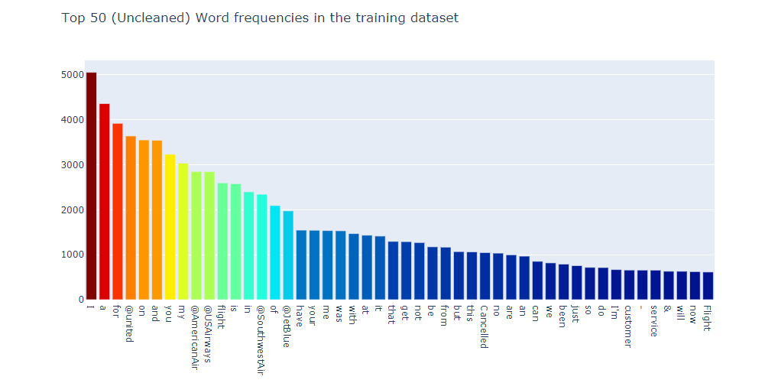
Insights observed

Slide 5
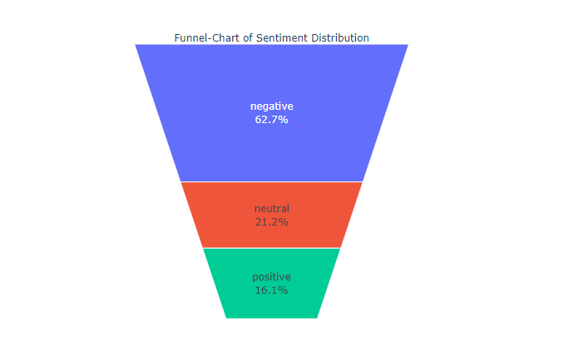

Slide 6
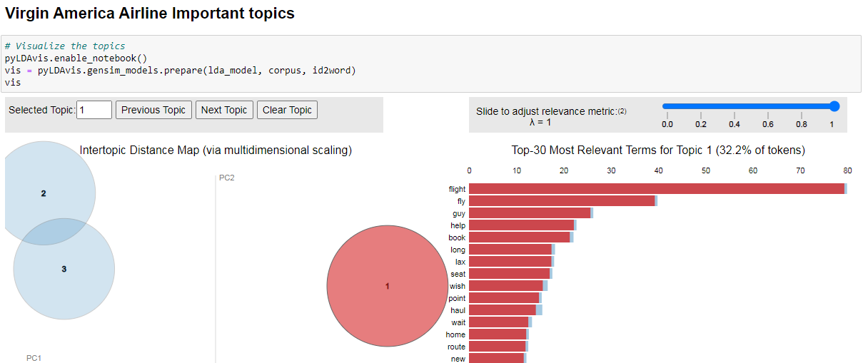

Slide 7
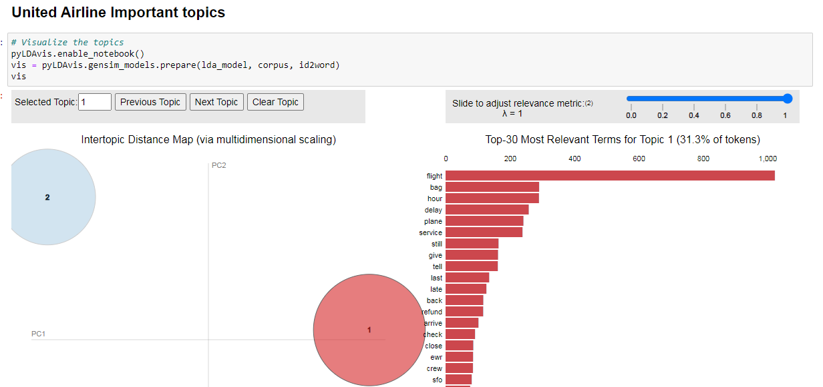

Slide 8
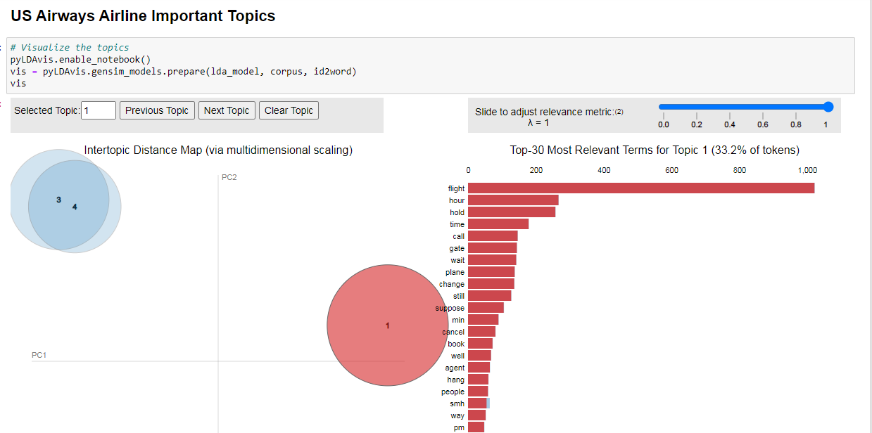

Slide 9
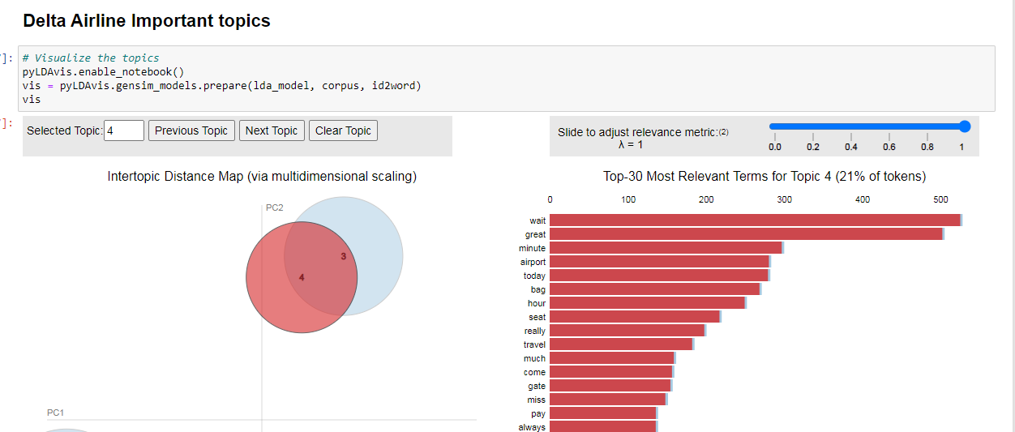

Slide 10
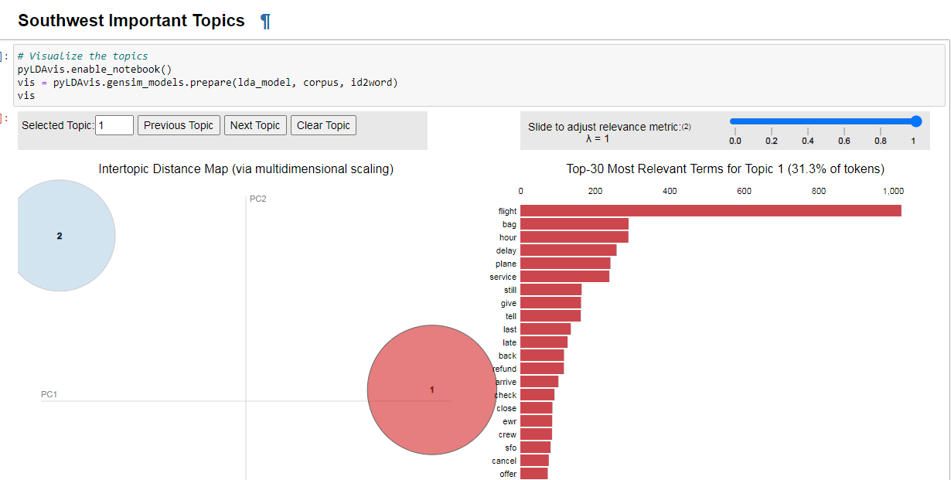

Slide 11
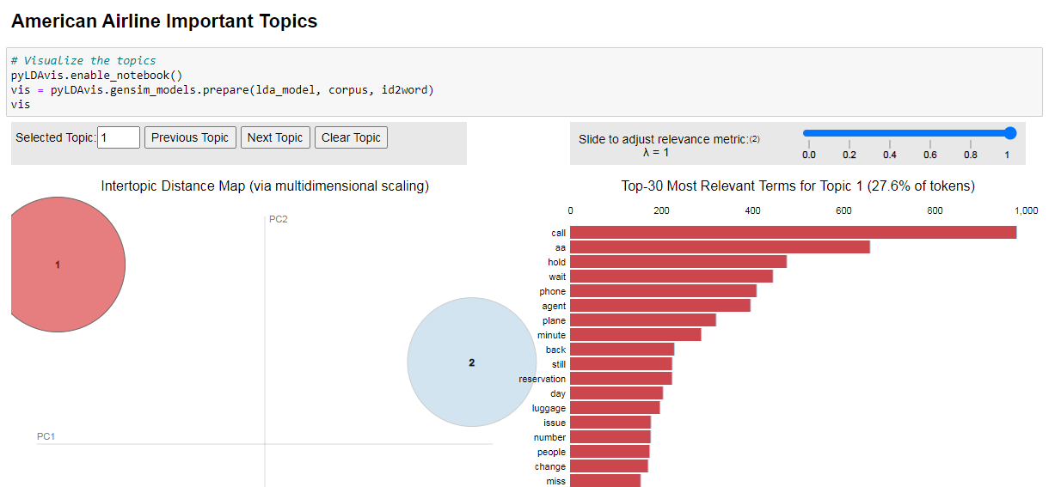

Slide 12
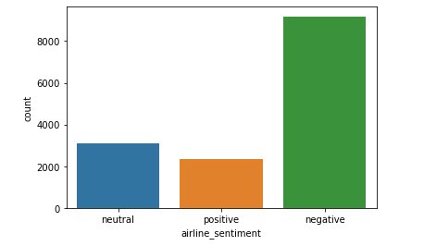

Slide 13
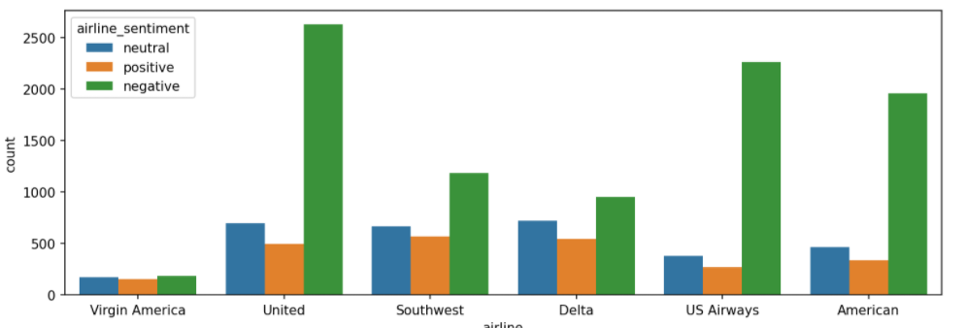

Slide 14
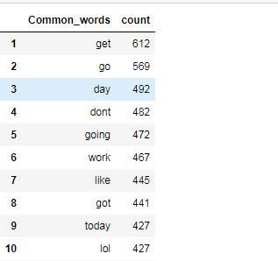
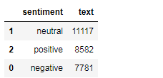

Slide 15
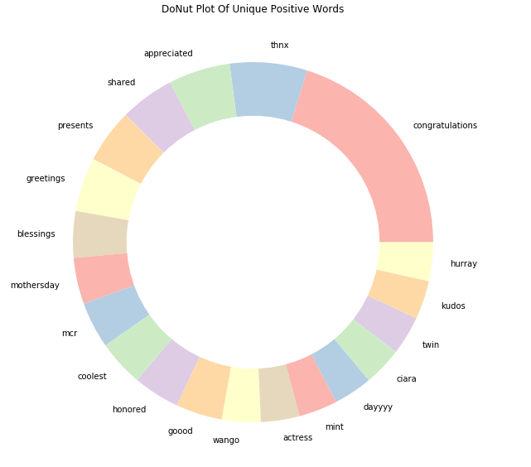

Slide 16
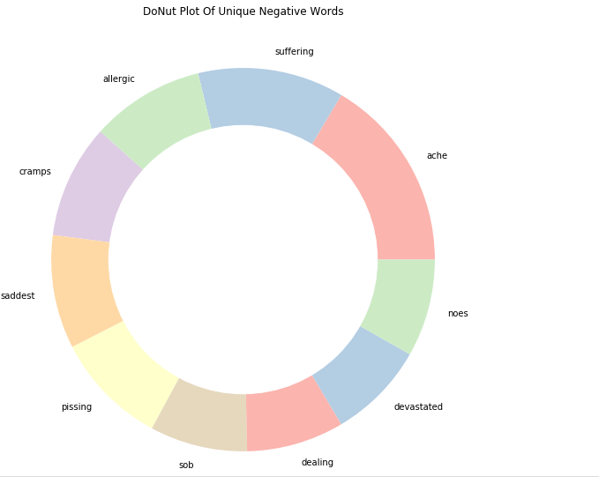

Slide 17
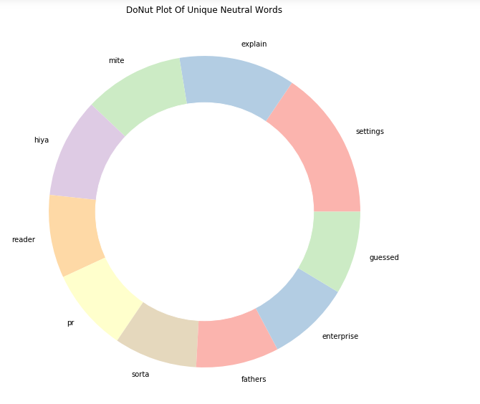

Slide 18
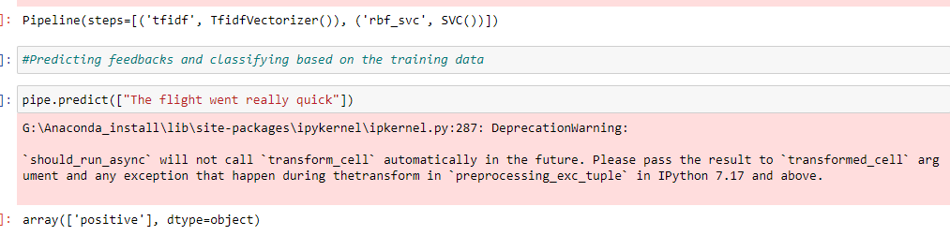
Predictions and classification

Slide 19
Topic modelling is the process in which we try uncover abstract themes or "topics" based on the underlying documents and words in a corpus of text. I will introduce two standard topic modelling techniques here with the first technique known as Latent Dirichlet Allocation (LDA) and the second Non-negative Matrix Factorization (NMF). I will also take the opportunity to introduce some Natural Language Processing basics such as Tokenization, Stemming and vectorization of the raw text which should also hopefully come in handy when making predictions with learning models.
The outline of this notebook is as follows:
Exploratory Data Analysis (EDA) and Wordclouds - Analyzing the data by generating simple statistics such word frequencies over the different authors as well as plotting some wordclouds (with image masks).
Natural Language Processing (NLP) with NLTK (Natural Language Toolkit) - Introducing basic text processing methods such as tokenizations, stop word removal, stemming and vectorizing text via term frequencies (TF) as well as the inverse document frequencies (TF-IDF)
Topic Modelling with LDA and NNMF - Implementing the two topic modelling techniques of Latent Dirichlet Allocation (LDA) and Non-negative Matrix Factorization (NMF).

